Slide 1
Child Welfare Advisory
Committee (CWAC)
April 2025

Slide 2

We are so glad you are here!
Please keep your lines MUTED (both computer and phone)
Use the CHAT box to interact with everyone
Please type your name and organization in the chat

Slide 3

DFS Updates
DMAS
Child and Family Services Review (CFSR) Overview
Data Review
Breakout Rooms: Systemic Factors Items 29-30: Array of Services and Individualizing Services
Plus/Delta

Slide 4
Child Welfare Advisory Committee (CWAC) Charge
CWAC: collaborative advisory group working together to achieve system outcomes.
Child welfare program, policy, training and practice
CFSP, annual progress reports and other state plans
Capacity Building and CQI
Collaboration and Partnerships
Notes:
You may recall this slide from our last meeting. CWAC is a collaborative advisory group whose charge is partner and advise how we get to our outcomes as a system. We are working on developing our partnerships in meeting the outcomes.
The items we’re working towards as a child welfare system include
Child welfare program, policy, training and practice issues
The development of the five-year Child and Family Services Plan and annual progress reports, as well as other state plans under the responsibility of Family Services including guiding the development and implementation of Virginia's Program Improvement Plan for any element that Virginia does not meet requirements of the Child and Family Services Review (CFSR)
Ensuring that we build capacity and CQI efforts in achieving and improving all of our outcomes
Let’s move to the next slide for a couple updates.

Slide 5


Division Updates
DFS program/project updates

Slide 6
DMAS – Medicaid’s Foster Care Specialty Plan program

Slide 7
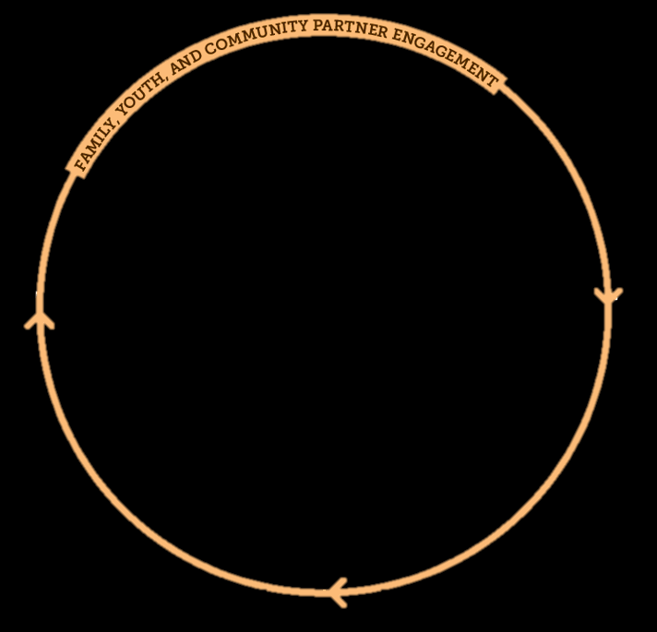
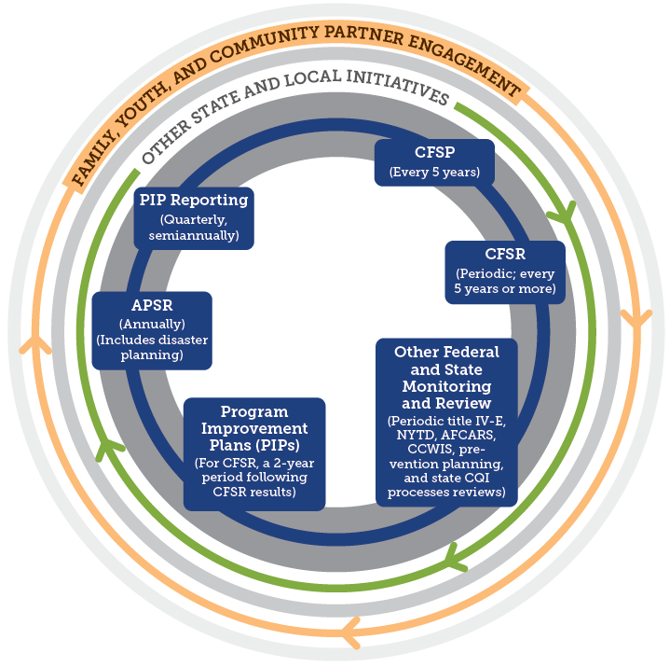
CFSR (Child and Family Services Review)
The CFSR is a periodic federal review of state child welfare systems to:
Ensure conformity with federal child welfare requirements;
Determine what is happening to children & families in the child welfare system; and
Assist states in enhancing their capacity to achieve safety, permanency & well-being.
Step 1: Statewide Assessment
Step 2: On Site Review
Step 3: Program Improvement Plan
Image from Strategic Planning in Child Welfare (Child Welfare Capacity Building Collaborative)
https://capacity.childwelfare.gov/states/topics/cqi/strategic-planning
Notes:
The 1994 Amendments to the Social Security Act authorize the U.S. Department of Health and Human Services to review state child and family service programs to ensure conformity with the requirements in titles IV-B and IV-E of the Social Security Act.
2000 Children’s Bureau final rule established CFSR processes.
Round 1: 2003
Round 2: 2009
Round 3: 2017
Currently in Round 4: 2023-2026
Virginia is a year 3 state, review beginning Oct 2025

Slide 8
CFSR Outcomes
Domains
Safety
Permanency
Well-being
Children are protected from abuse and neglect
Children are safely maintained in their homes when possible
Children have permanency in their living situations
Continuity of relationships and connections are preserved for children
Families have enhanced capacity to meet their children’s needs
Children receive appropriate services to meet their educational needs
Children receive appropriate services to meet physical and mental health needs
Systemic Factors
Statewide Information System
Case review system
Quality assurance system
Staff and provider training
Service array
Agency responsiveness to community
Resource/adoptive parent licensing, recruitment, and retention
Notes:
During a federal CFSR, the feds look at multiple outcomes during our onsite review and statewide assessment processes. They assess our child welfare system as a whole through 7 systemic factors listed here. They also assess our casework practices in the domains of safety, permanency and well-being.

Slide 9
Step 1: Statewide Assessment
Opportunity for VA to collect and analyze data to evaluate child welfare system.
  Assessing Performance on Outcomes through:
    Administrative Data
    Case review Data
    Data Indicators
  Assessing Performance on Systemic Factors through:
    Administrative Data
    Interviews/Focus Groups
    Surveys
Notes:
During a federal CFSR, the feds look at multiple outcomes during our onsite review and statewide assessment processes.

Slide 10
Step 2: On Site Review
Outcomes
Safety
Permanency
Well-being
Children are protected from abuse and neglect
Children are safely maintained in their homes when possible
Children have permanency in their living situations
Continuity of relationships and connections are preserved for children
Families have enhanced capacity to meet their children’s needs
Children receive appropriate services to meet their educational needs
Children receive appropriate services to meet physical and mental health needs
Approved for State-Led Review Process
Review casework for performance in the 7 outcomes related to safety, permanency & Well-being
Stakeholder Interviews to continue assessment of systemic factor functioning

Slide 11
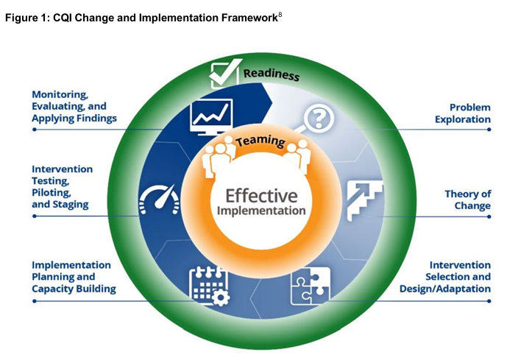
Step 3: Performance Improvement Plan (PIP)
Collaborative process between state and federal partners with engagement of stakeholders
Targets the practice and systemic concerns identified in the CFSR
Importance of using a robust CQI framework
https://www.cfsrportal.acf.hhs.gov/document/download/xEeKGR

Slide 12
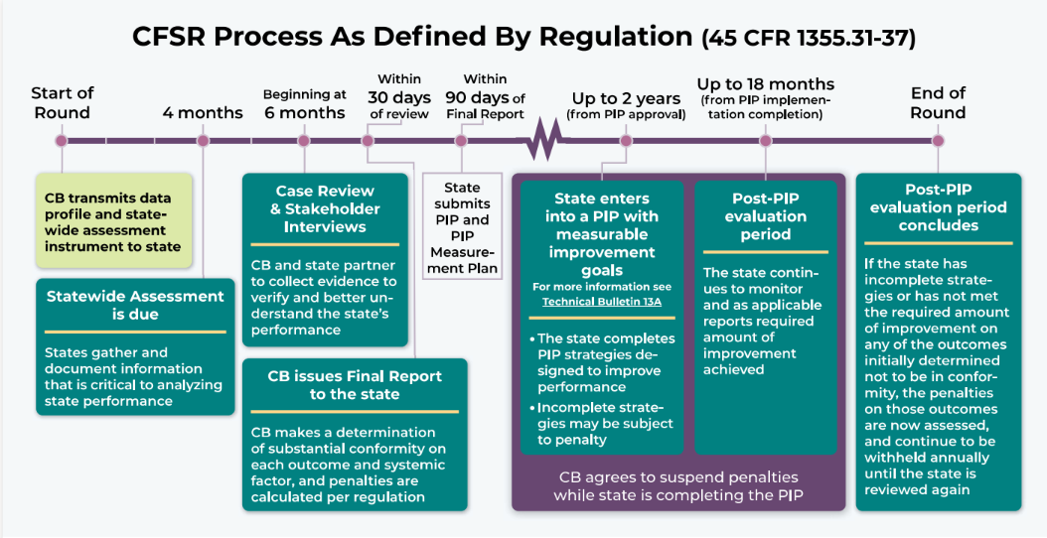
CFSR R4 Process Graphic
Notes:
The start of our round will officially begin in October 2025. In preparation, we are currently gathering data for our statewide assessment. Engagement of key stakeholder groups to obtain feedback and data for the statewide assessment is critical. This includes lived experience, tribes, service providers, legal/judicial partners.
We will then complete stakeholder interviews and begin the case review process. As part of the federal review a total of 70 cases from local agencies will be reviewed over the course of two quarters. Our federal partners will also conduct interviews with our key stakeholder groups to ask questions about our systemic factor outcomes.
Upon the completion of our review process, the children’s bureau will issue a final report to our state based on the outcomes of both the case reviews and our statewide assessment. Based on the feedback, Virginia will enter into our PIP. Stakeholders and partners will be selected to participate in our PIP development, and several LDSS agencies will be selected to serve as pilot agencies for initiatives to improve our child welfare outcomes. Once Virginia has achieved all goals identified in the PIP, we will have reached the end of our CFSR round 4.

Slide 13
Past CFSR Performance (2017)
0 of the 7 outcomes were found in substantial conformity
Safety
  Children are, first and foremost, protected from abuse and neglect.
  Children are safely maintained in their homes whenever possible and appropriate.
Permanency
  Children have permanency and stability in their living situations.
  The continuity of family relationships and connections is preserved for children.
Well-Being
  Families have enhanced capacity to provide for their children’s needs.
  Children receive appropriate services to meet their educational needs.
  Children receive adequate services to meet their physical and mental health needs.
4 of the 7 systemic factors were found in substantial conformity
  Statewide Information System
  Quality Assurance System
  Agency Responsiveness to the Community
  Foster and Adoptive Parent Licensing, Recruitment, and Retention
  3 not in substantial conformity:
    Case Review System
    Staff and Provider Training
    Service Array & Resource Development
Notes:
Our most recent past CFSR was completed in 2017.
We were not found in substantial conformity with any of the 7 outcomes (They are broken apart into safety, permanency and well-being and are listed on the slide). We were found in substantial conformity with 4 of the 7 systemic factors (statewide information system*, quality assurance system, agency responsiveness to the community, and foster & adoptive parent licensing, recruitment, and retention). We were not found in substantial conformity with 3 of the systemic factors including case review, staff & provider training, and service array & resource development).
*statewide information systems systemic factor assesses the ability of staff to access certain information from the statewide information system (such as demographic details etc). Virginia’s outdated child welfare information system has impacted VDSS’ ability to report data in several of our other systemic factors. CCWIS is expected to relieve some of these issues.

Slide 14
Program Improvement Plan (PIP) Overview
PIP closeout letter Feb 2022
Significant development effort across multiple stakeholder groups
PIP approval granted in April 2019.
20 PIP Localities
Statewide implementation
Development
Implementation
Notes:
VDSS was notified upon completion of the CFSR 2017 Final Report that Virginia would need to implement a Program Improvement Plan (PIP). VDSS underwent significant root cause analysis and engagement of multiple stakeholder groups to develop the PIP. VDSS submitted the first draft of the PIP in January 2018.
Our federal partners are particular about what is included in an approvable PIP and the CFSR PIP process requires root cause analysis and solutioning with stakeholders. VDSS was able to obtain PIP approval on the 6th submission in April 2019.
VDSS implemented the PIP in 2019 with 20 PIP localities and 7 workgroups which worked to implement PIP strategies with the 20 localities and then expand statewide. We received the PIP closeout letter Feb 2022.

Slide 15
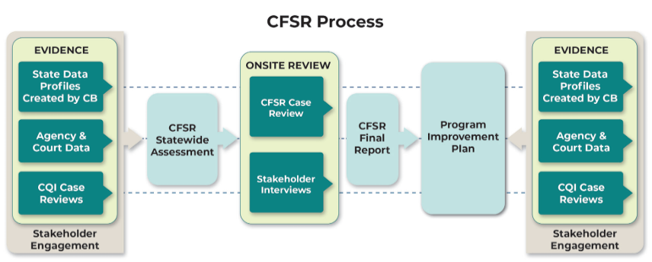
Virginia CFSR Round 4 Timeline
Submission: 9/15/2026
PIP: up to 2 years from date of approval
Post PIP monitoring: Up to 18 months after PIP completion
11/3-11/7/2025
8/1/2025
6/15/2026
10/1/25-3/31/26
Now - 8/1/2025

Slide 16

Importance of Stakeholder Engagement
Key partners and stakeholders provide valuable assessments of how the child welfare system is functioning in Virginia.
Hearing from parents and youth about their experiences is essential to making the system better.
Stakeholders help identify strengths, challenges, gaps, and ways to improve the variety of domains in the CFSR.

Slide 17

BREAK – Return @ 2:05pm
Notes:
Pass it back to Sadie

Slide 18
Today’s Focus
Statewide Information System
Item 19: Statewide Information System
Case Review
Item 20: Written Case Plan
Item 22: Permanency Reviews
Quality Assurance System
Item 25: Quality Assurance System
Item 21: Periodic Reviews
Item 23: Termination of Parental Rights
Item 24: Notice of Hearings and Reviews to Caregivers
Staff and Provider Training
Service Array and Resource Development
Agency Responsiveness to the Community
Foster & Adoptive Parent Licensing, Recruitment, & Retention
Item 26: Initial Staff Training
Item 27: Ongoing Staff Training
Item 28: Foster and Adoptive Parent Training
Item 29: Array of Services
Item 30: Individualizing Services
Item 31: State Engagement and Consultation with Stakeholder Pursuant to the CFSP/APSR
Item 32: Coordination of CFSP Services with Other Federal Programs
Item 33: Standards Applied Equally
Item 34: Requirements for Criminal Background Checks
Item 35: Diligent Recruitment of Foster and Adoptive Homes
Item 36: State Use of Cross-Jurisidictional Resources for Permanent Placements

Slide 19
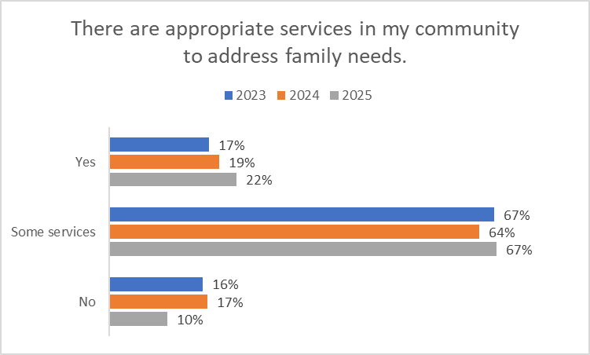
LDSS Child Welfare Survey Data

Slide 20
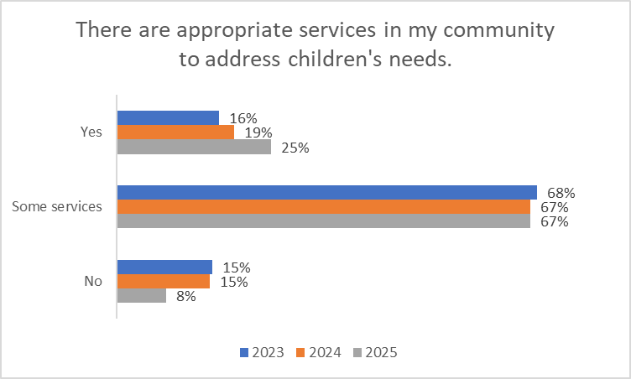
LDSS Child Welfare Survey

Slide 21
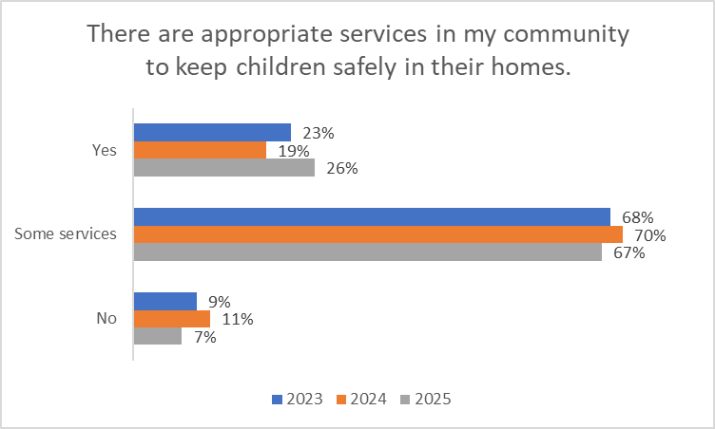
LDSS Child Welfare Survey

Slide 22
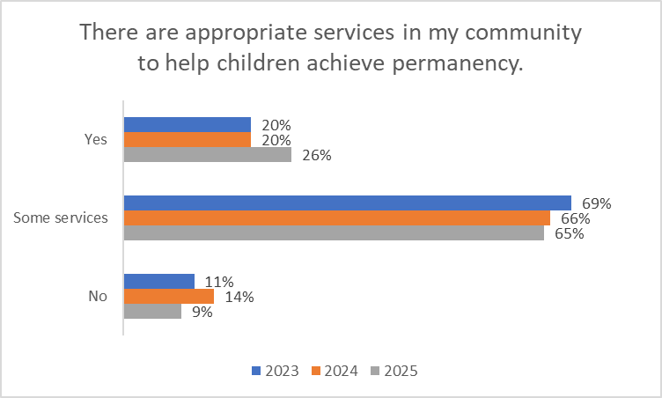
LDSS Child Welfare Survey

Slide 23
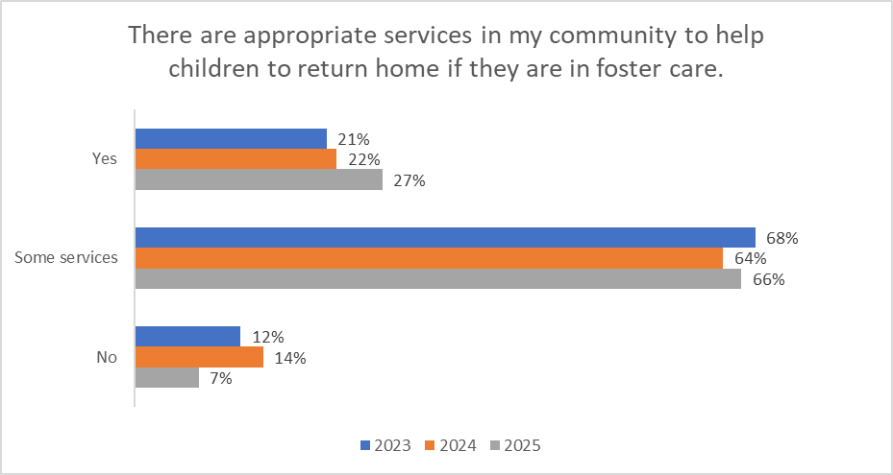
LDSS Child Welfare Survey

Slide 24
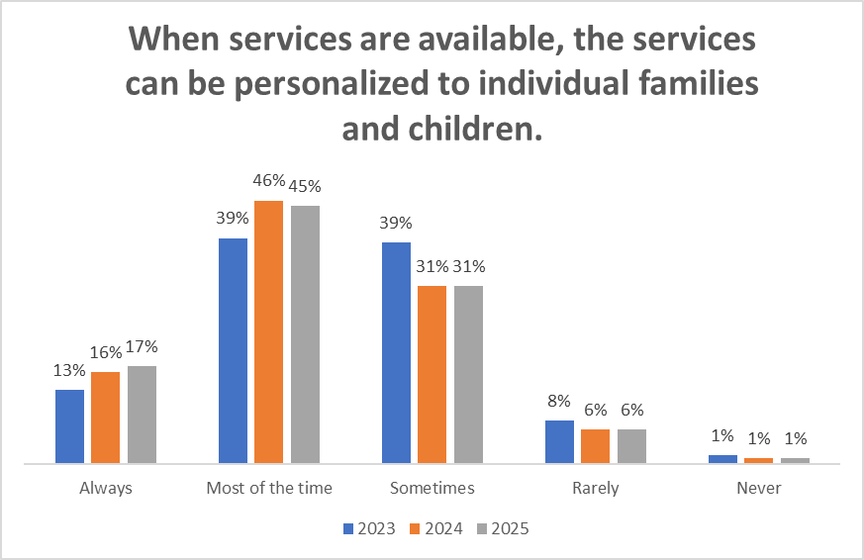
LDSS Child Welfare Survey

Slide 25
Systemic Factors and Breakout Rooms
Item 29: Array of Services
  How well is the service array and resource development system functioning to ensure that the following array of services is available and accessible in all political jurisdictions covered by the CFSP?
    Services that assess the strengths and needs of children and families and determine other service needs;
    Services that address the needs of families in addition to individual children in order to create a safe home environment;
    Services that enable children to remain safely with their parents when reasonable; and
    Services that help children in foster and adoptive placements achieve permanency.
Item 30: Individualizing Services
  How well is the service array and resource development system functioning statewide to ensure that the services in Item 29 can be individualized to meet the unique needs of children and families served by the agency?

Slide 26
Breakout Rooms
Services: Assessing Strengths & Needs
Services: Addressing Needs to Create a Safe Home
Services: Enabling Children to Remain Safely with Parents
Individualizing services
Services: Helping children achieve permanency

Slide 27

Plus / Delta
Notes:
For those who are new to this meeting: plusses what went well and we should consider continuing on for future meetings. For deltas, what we should consider changing for our next meeting . Start with plusses.

Slide 28

Next meeting: June 12th @ 1:30pm
Notes:
Resources:
CFSR General Fact Sheet
CFSR Fact Sheet for Legal Judicial Communities
History:
2017 Statewide Assessment Virginia 2017 CFSR Statewide Assessment of Systemic Factors
2017 CFSR Final Report VA_CFSR_Final_Report_2017
2019 PIP Virginia CFSR Round 3 Program Improvement Plan

