Slide 1
Child Welfare Advisory
Committee (CWAC)
June 2025

Slide 2

Welcome!
We are so glad you are here!
Please keep your lines MUTED (both computer and phone)
Use the CHAT box to interact with everyone
Please type your name and organization in the chat
Notes:
Just a couple of housekeeping items - Please keep yourself muted and utilize the chat.

Slide 3
Agenda
DFS Updates
Child and Family Services Review (CFSR) Overview
Data Review
Breakout Rooms: Systemic Factors Items 26-28: Initial Staff Training, Ongoing Staff Training, and Foster and Adoptive Parent Training
Plus/Delta

Slide 4
Child Welfare Advisory Committee (CWAC) Charge
CWAC: collaborative advisory group working together to achieve system outcomes.
Child welfare program, policy, training and practice
CFSP, annual progress reports and other state plans
Capacity Building and CQI
Collaboration and Partnerships
Notes:
You may recall this slide from our last meeting. CWAC is a collaborative advisory group whose charge is partner and advise how we get to our outcomes as a system. We are working on developing our partnerships in meeting the outcomes.
The items we’re working towards as a child welfare system include
Child welfare program, policy, training and practice issues
The development of the five-year Child and Family Services Plan and annual progress reports, as well as other state plans under the responsibility of Family Services including guiding the development and implementation of Virginia's Program Improvement Plan for any element that Virginia does not meet requirements of the Child and Family Services Review (CFSR)
Ensuring that we build capacity and CQI efforts in achieving and improving all of our outcomes
Let’s move to the next slide for a couple updates.

Slide 5


Division Updates
DFS program/project updates
  Safe Kids, Strong Families
  Kinship Navigator IV-E Plan Amendment

Slide 6

Safe Kids, Strong Families will focus on 6 pillars
Safe Kids, Strong Families
1
2
3
4
5
6
Modernization of Oversight and Infrastructure
Strengthening the Workforce
Prevention and Family Preservation
Child Protective Services
Permanency for Youth
Behavioral Health and Child Welfare

Slide 7
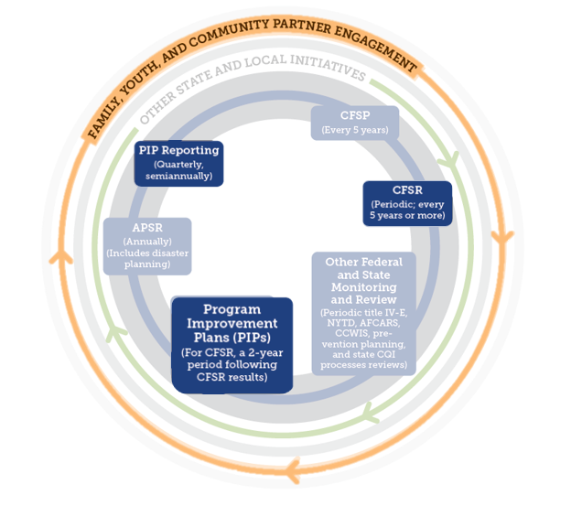
CFSR (Child and Family Services Review)
The CFSR is a periodic federal review of state child welfare systems to:
Ensure conformity with federal child welfare requirements;
Determine what is happening to children & families in the child welfare system; and
Assist states in enhancing their capacity to achieve safety, permanency & well-being.
Step 1: Statewide Assessment
Step 2: On Site Review
Step 3: Program Improvement Plan
Image from Strategic Planning in Child Welfare (Child Welfare Capacity Building Collaborative)
https://capacity.childwelfare.gov/states/topics/cqi/strategic-planning
Notes:
The 1994 Amendments to the Social Security Act authorize the U.S. Department of Health and Human Services to review state child and family service programs to ensure conformity with the requirements in titles IV-B and IV-E of the Social Security Act.
2000 Children’s Bureau final rule established CFSR processes.
Round 1: 2003
Round 2: 2009
Round 3: 2017
Currently in Round 4: 2023-2026
Virginia is a year 3 state, review beginning Oct 2025
https://www.cfsrportal.acf.hhs.gov/resources/round-4-resources/cfsr-round-4-process/cfsr-overview-video/video

Slide 8
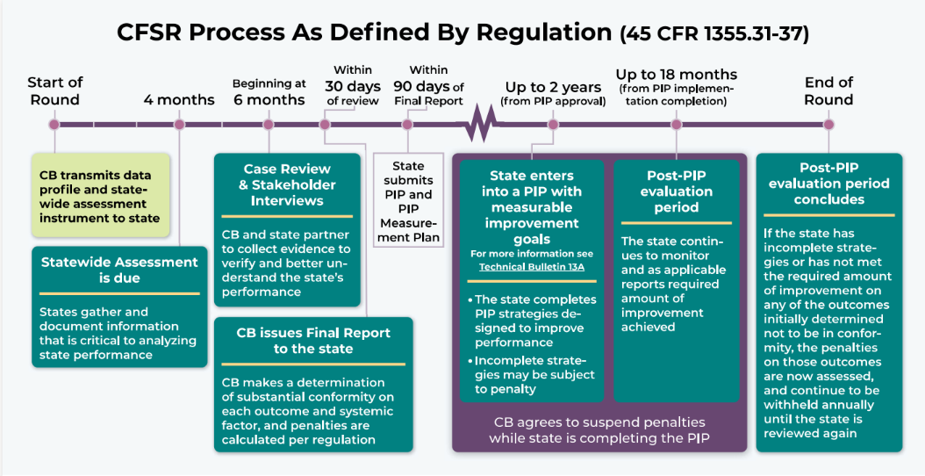
CFSR R4 Process Graphic
Notes:
The start of our round will officially begin in October 2025. In preparation, we are currently gathering data for our statewide assessment. Engagement of key stakeholder groups to obtain feedback and data for the statewide assessment is critical. This includes lived experience, tribes, service providers, legal/judicial partners.
We will then complete stakeholder interviews and begin the case review process. As part of the federal review a total of 70 cases from local agencies will be reviewed over the course of two quarters. Our federal partners will also conduct interviews with our key stakeholder groups to ask questions about our systemic factor outcomes.
Upon the completion of our review process, the children’s bureau will issue a final report to our state based on the outcomes of both the case reviews and our statewide assessment. Based on the feedback, Virginia will enter into our PIP. Stakeholders and partners will be selected to participate in our PIP development, and several LDSS agencies will be selected to serve as pilot agencies for initiatives to improve our child welfare outcomes. Once Virginia has achieved all goals identified in the PIP, we will have reached the end of our CFSR round 4.

Slide 9
CFSR Round 4 Preparation
May – July 2025:
  Last quarter of regular CFSR reviews
  Incorporating all Round 4 federal criteria – FS cases and THV for PUR
  Communicating with LDSS regarding participation as stakeholder reviewers in Round 4
August – September 2025
  Stakeholder review training
  Final CFSR Round 4 Webinars for LDSS/VDSS
  Special projects – preparation of review materials and policy
October 2025 – March 2026
  Federal Case Review Process
  Children’s Bureau Stakeholder Interview week (November 2025)

Slide 10
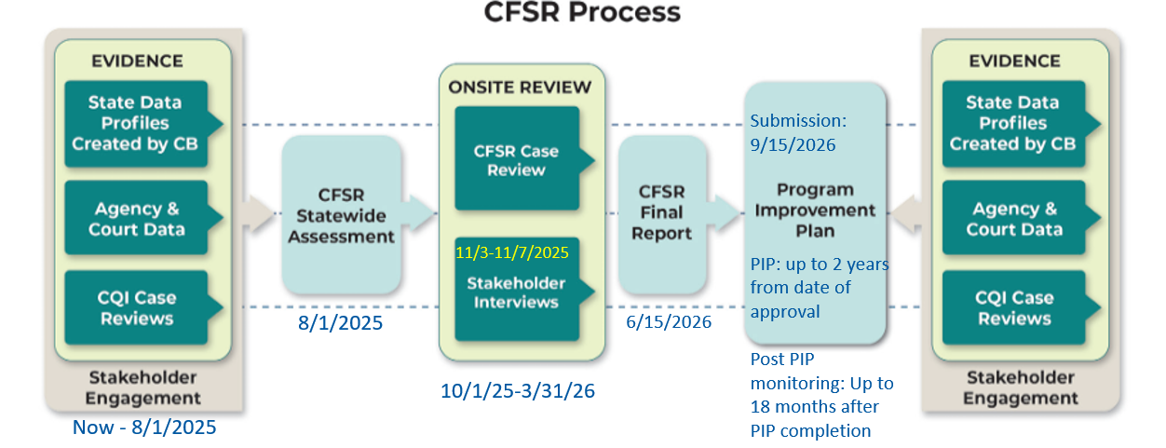
Virginia CFSR Round 4 Timeline

Slide 11
Today’s Focus
Statewide Information System
  Item 19: Statewide Information System
Case Review
  Item 20: Written Case Plan
  Item 21: Periodic Reviews
  Item 22: Permanency Reviews
  Item 23: Termination of Parental Rights
  Item 24: Notice of Hearings and Reviews to Caregivers
Quality Assurance System
  Item 25: Quality Assurance System
Staff and Provider Training
  Item 26: Initial Staff Training
  Item 27: Ongoing Staff Training
  Item 28: Foster and Adoptive Parent Training
Service Array and Resource Development
  Item 29: Array of Services
  Item 30: Individualizing Services
Agency Responsiveness to the Community
  Item 31: State Engagement and Consultation with Stakeholder Pursuant to the CFSP/APSR
  Item 32: Coordination of CFSP Services with Other Federal Programs
Foster & Adoptive Parent Licensing, Recruitment, & Retention
  Item 33: Standards Applied Equally
  Item 34: Requirements for Criminal Background Checks
  Item 35: Diligent Recruitment of Foster and Adoptive Homes
  Item 36: State Use of Cross-Jurisdictional Resources for Permanent Placements

Slide 12
Item 26 – LDSS Child Welfare Survey Data

Slide 13
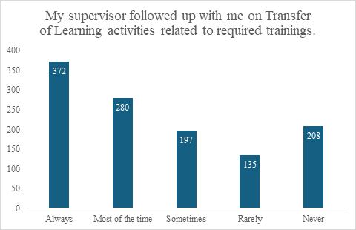
Item 26: LDSS Child Welfare Survey
Additionally, 1,071 out of the 1,203 respondents (89%) agreed or strongly agreed that supervisors encourage attendance at required training.
N=1192

Slide 14
Item 26: LDSS Child Welfare Survey, cont

Slide 15
Item 26: Stakeholder Input
Youth
  SPEAKOUT
    Strengths - understanding youth’s identity, and training on some mental health (anxiety, depression).
    ANIs - More training on caring for youth on the autism spectrum and preventing mislabeling behaviors as defiant; having questions shouldn’t be seen as defiance; Understanding age/developmentally appropriate ways to communicate with youth.
  Project Life Conference
    Strengths – length of time in training, trained well to provide info, realistic discussions with youth, taking time to get to know youth
    ANI – not feeling heard when speaking up, LGBTQ+ training, consistency in contact, supporting youth in their homes, etc
Parents
  Parent Advisory Council
    ANIs - More training needed on DV and impacts in home (hands-on/shadowing); Cross-section of DV/mental health; understanding/communicating with children age-appropriately; children’s development/response to trauma and abuse; Children’s mental health; Understanding/working with single parents (Stereotypes/stigmas); Poor communication- no call back or follow-up; Accuracy of case documentation; Providing addition support/information to parents to obtain support/services (legal aide, etc); Importance of parent advocates (parent support partner)

Slide 16
Item 27: LDSS Child Welfare Survey

Slide 17
Item 27: LDSS Child Welfare Survey

Slide 18
Item 28: Foster Parent Survey

Slide 19
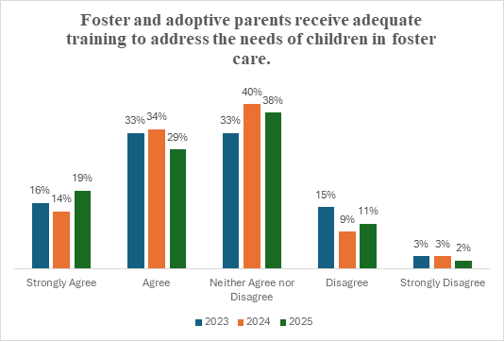
Item 28: LDSS Child Welfare Survey

Slide 20
Item 28: Stakeholder Feedback
Youth
  SPEAKOUT
    Strengths - caring for children with suicidal ideations, understanding youth’s identity, and training on some mental health (anxiety, depression).
    ANIs - Treating children differently; Understanding youth are youth and given appropriate chores and roles for a youth in a home; Food accommodations and preferences and preventing unhealthy eating habits; More training on caring for youth on the autism spectrum and preventing mislabeling behaviors as defiant; Understanding age/developmentally appropriate ways to communicate with youth.
Youth
  Project Life Conference
    Strengths - better training to care for younger children and support after placement
    ANI - better training for older youth, more mental health training, more cultural training (ex. help with hair), having the right motivation, and how to listen to youth.
Parents
  Parent Advisory Council
    ANIs - overall lack of training for foster parents and that there was a lack of communication between the foster parent and the parent and between the foster parent and the agency.

Slide 21
BREAK
Take a 5 minute break…Return at 2:36 PM

Slide 22
Systemic Factors and Breakout Rooms
Item 26: Staff Training – Initial
  How well is the staff and provider training system functioning statewide to ensure that initial training is provided to all staff who deliver services pursuant to the Child and Family Services Plan (CFSP) so that:
    Staff receive training in accordance with the established curriculum and timeframes for the provision of initial training; and
    The system demonstrates how well the initial training addresses the basic skills and knowledge needed by staff to carry out their duties
Item 27: Staff Training – Ongoing
  How well is the staff and provider training system functioning statewide to ensure that ongoing training is provided for staff that addresses the skills and knowledge needed to carry out their duties with regard to the services included in the CFSP so that:
    Staff receive ongoing training pursuant to the established curriculum and timeframes for the provision of ongoing training; and
    The system demonstrates how well the ongoing training addresses the skills and knowledge needed by staff to carry out their duties?
Item 28: Foster and Adoptive Parent Training
  How well is the staff and provider training system functioning to ensure that training is occurring statewide for current or prospective foster parents, adoptive parents, and staff of state licensed or approved facilities (who receive title IV-E funds to care for children) so that:
    Current or prospective foster parents, adoptive parents, and staff receive training pursuant to the established annual/biannual hourly/continuing education requirement and timeframes for the provision of initial and ongoing training; and
    The system demonstrates how well the initial and ongoing training addresses the skills and knowledge base needed to carry out their duties with regard to foster and adopted children?

Slide 23
Breakout Rooms – Pick relevant room to join
1 – Training for Foster Parents (LDSS/LCPA)
2 – Training for LDSS Staff - Initial
3 – Training for LDSS Staff - Ongoing
4 – Training for Residential Staff/LCPA case managers

Slide 24

Plus / Delta
Notes:
For those who are new to this meeting: plusses what went well and we should consider continuing on for future meetings. For deltas, what we should consider changing for our next meeting . Start with plusses.

Slide 25

Next meeting: August 14th
Notes:
Resources:
CFSR General Fact Sheet
CFSR Fact Sheet for Legal Judicial Communities
History:
2017 Statewide Assessment Virginia 2017 CFSR Statewide Assessment of Systemic Factors
2017 CFSR Final Report VA_CFSR_Final_Report_2017
2019 PIP Virginia CFSR Round 3 Program Improvement Plan

